Slide 1
Network Trouble Shooting

Slide 2
Trouble Shooting
Trouble shooting is a form of problem solving, often applied to repair failed products or processes.
It is a logical, systematic search for the source of a problem so that it can be solved, and so the product or process can be made operational again.
Troubleshooting is used in many fields such as engineering, system administration, electronics, automotive repair, and diagnostic medicine.
Troubleshooting requires identification of the malfunction(s) or symptoms within a system.

Slide 3
NETWORK TROUBLE SHOOTING USING : PING
Ping is a basic Internet program that allows a user to verify that a particular IP address exists.
Ping is used diagnostically to ensure that a host computer the user is trying to reach is actually operating.
Ping works by sending an Internet Control Message Protocol (ICMP) Echo Request to a specified interface on the network and waiting for a reply.
Ping can be used for troubleshooting to test connectivity and determine response time can accept requests.

Slide 4
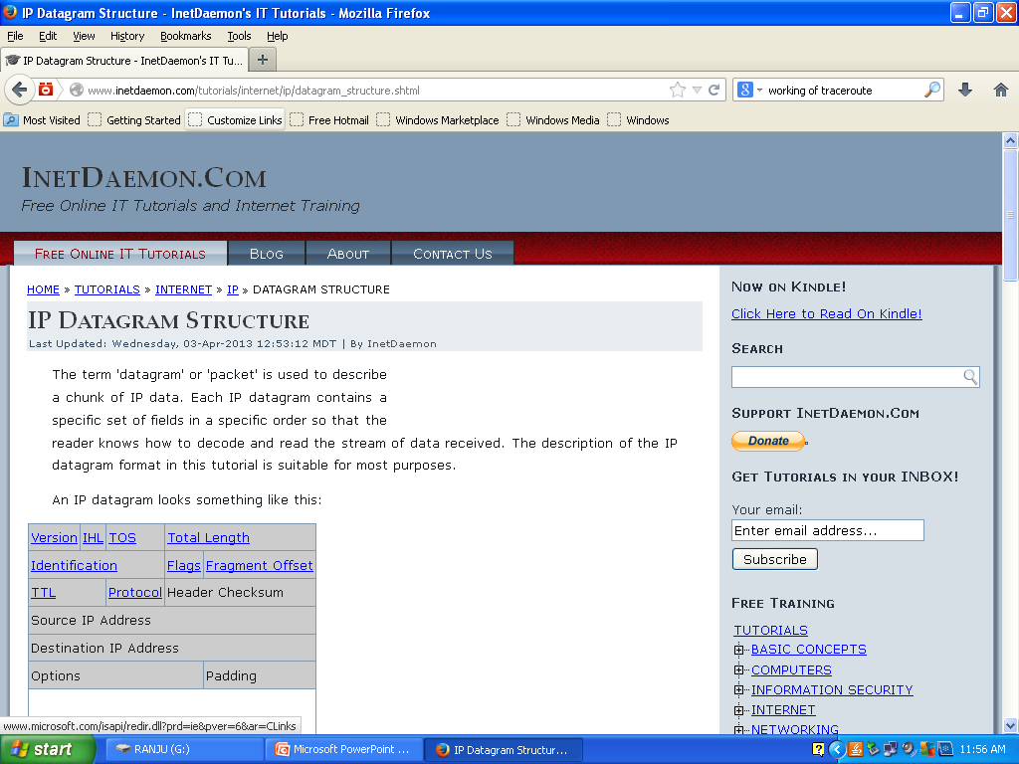
Working of ping
The source host generates an ICMP protocol data unit.
The ICMP PDU is encapsulated in an IP datagram, with the source and destination IP addresses in the IP header.
The source host notes the local time on it's clock as it transmits the IP datagram towards the destination. Each host that receives the IP datagram checks the destination address to see if it matches their own address or is the all hosts address (all 1's in the host field of the IP address).
If the destination IP address in the IP datagram does not match the local host's address, the IP datagram is forwarded to the network where the IP address resides.
The destination host receives the IP datagram, finds a match between itself and the destination address in the IP datagram.

Slide 5
The destination host notes the ICMP ECHO information in the IP datagram, performs any necessary work then destroys the original IP/ICMP ECHO datagram.
The destination host creates an ICMP ECHO REPLY, encapsulates it in an IP datagram placing it's own IP address in the source IP address field, and the original sender's IP address in the destination field of the IP datagram.
The new IP datagram is routed back to the originator of the PING.
The host receives it, notes the time on the clock and finally prints PING output information, including the elapsed time

Slide 6
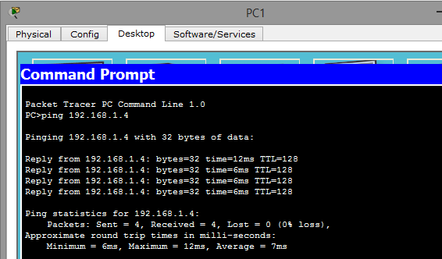
ping command

Slide 7
Traceroute
In computing, traceroute is a computer network diagnostic tool for displaying the route (path) and measuring transit delays of packets across an Internet Protocol.
The history of the route is recorded as the round-trip times of the packets received from each successive host (remote node) in the route (path); the sum of the mean times in each hop indicates the total time spent to establish the connection (IP) network.
Traceroute proceeds unless all (three) sent packets are lost more than twice, then the connection is lost and the route cannot be evaluated. Ping, on the other hand, only computes the final round-trip times from the destination point.

Slide 8
Working of trace route
When you execute a traceroute command (ie traceroute www.yahoo.com), your machine sends out 3 UDP packets with a TTL (Time-to-Live) of 1. When those packets reach the next hop router, it will decrease the TTL to 0 and thus reject the packet. TTL equal 0 during transit (Code 0) back to your machine - with a source address of itself, therefore you now know the address of the first router in the path.
Next your machine will send 3 UDP packets with a TTL of 2, thus the first router that you already know passes the packets on to the next router after reducing the TTL by 1 to 1. The next router decreases the TTL to 0, thus rejecting the packet
If during the session, you receive * * *, this could mean that that router in the path does not return ICMP messages, it returns messages with a TTL too small to reach your machine or a router with buggy softwareyou now know the first 2 routers in the path.

Slide 9
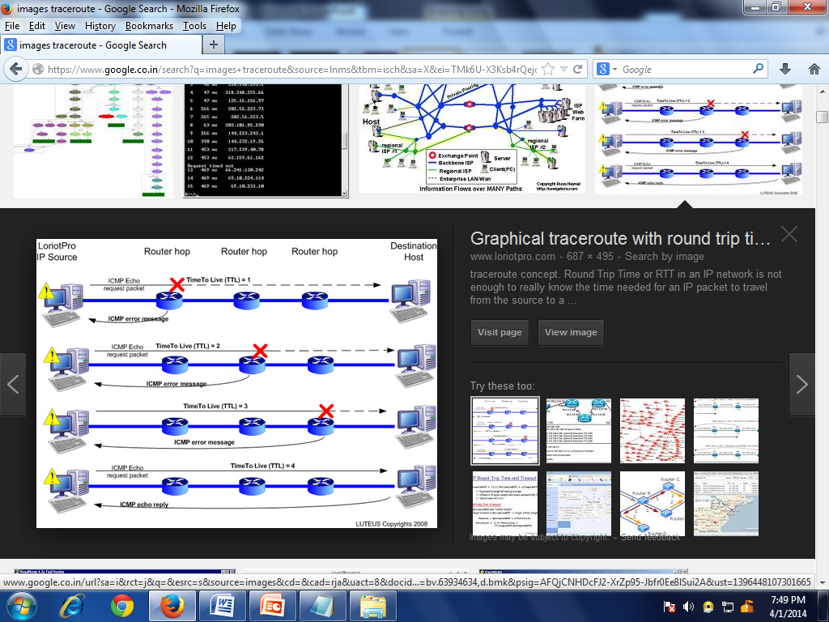
TRACEROUTE

Slide 10
Ipconfig
Ipconfig (sometimes written as IPCONFIG) is a command line tool used to control the network connections on Windows NT/2000/XP machines.
There are three main commands: "all", "release", and "renew".
Ipconfig displays all current TCP/IP network configuration values and refreshes Dynamic Host Configuration Protocol (DHCP) and Domain Name System (DNS) settings.
Used without parameters, ipconfig displays the IP address, subnet mask, and default gateway for all adapters.
IPCONFIG /all Display full configuration information.
IPCONFIG /release [adapter]
Release the IP address for the specified adapter.
IPCONFIG /renew [adapter]
Renew the IP address for the specified adapter.

Slide 11
Netstat
In computing, netstat (network statistics) is a command-line tool that displays network connections (both incoming and outgoing), routing tables, and a number of network interface and network protocol statistics.
It is used for finding problems in the network and to determine the amount of traffic on the network as a performance measurement.
It is available on Unix-like operating systems including OS X, Linux, Solaris, Windows XP, Windows Vista, Windows 7 and Windows 8.
Netstat provides information and statistics about protocols in use and current TCP/IP network connections.

Slide 12
Parameters of netstat
-a Displays all active connections and the TCP and UDP ports on which the computer is listening.
-b (Windows) Displays the binary (executable) program's name involved in creating each connection or listening port.
-b (OS ) Causes -i to report the total number of bytes of traffic.
-e Displays Ethernet statistics, such as the number of bytes and packets sent and received.

Slide 13
Nslookup
The name "nslookup" means "name server lookup".
definition: nslookup is a network utility program used to obtain information about Internet servers.
nslookup is a network administration command-line tool available for many computer operating systems for querying the Domain Name
C:\> nslookup
Default Server: resolver1.opendns.com
Address: 208.67.222.222

Slide 14
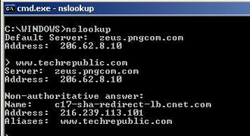
Example of nslookup

Slide 15
THANK YOU
QUERIES WILL BE NEGLECTED

